Slide 1
Canonical Take Home Test- PACE Framework
Planning
Setting Goals and Objectives, understanding data
Analyzing
EDA - Identifying relationships and correlations
Constructing
Classification Models, Hyperparameter tuning
Executing
Feature Importance, Recommendations

Slide 2
Planning
Defining Objectives
Modelling, strategies and recommendations
Initial understanding of the data
Data Cleaning
Identifying any duplicates
Treat missing values using mean imputation based on existing information such as age
Feature Engineering
Creating Hours Worked, Days Off values for each employee based on in_time, out_time
Merging Tables
Merging tables based on EmployeeID

Slide 3
Analyzing
Further understanding the data
Distribution and Correlation Heatmap
Visualizing relationships between highly correlated variables with attrition
Working Hours vs Attrition
Marital Status vs Attrition
Travel Frequency vs Attrition
TotalWorkingYears vs Attrition
Attrition in different departments
Attrition in different Job Roles

Slide 4
Constructing
Data Preparation
MinMaxScaler, TrainTestSplit, RandomOversampling
Constructing models with GridSearchCV, Classification Report and Confusion Matrix
Logistic Regression
Decision Tree
Random Forest
XGBoost

Slide 5
Executing
Weighted Feature Importance Aggregation
Decision Tree (15%), Random Forest (25%), XGBoost (60%
Understanding Top 5 Feature Importances (based on combination of aggregated and XGBoost importance)
Hours Worked
Age
Human Resources Department
Marital Status
Monthly Income

Slide 6
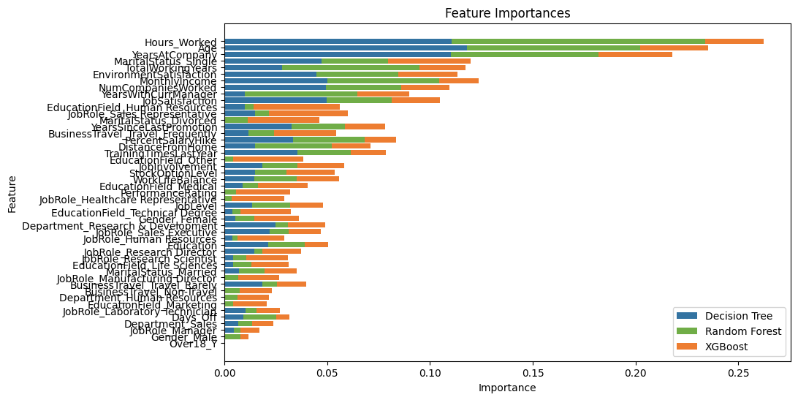

Slide 7
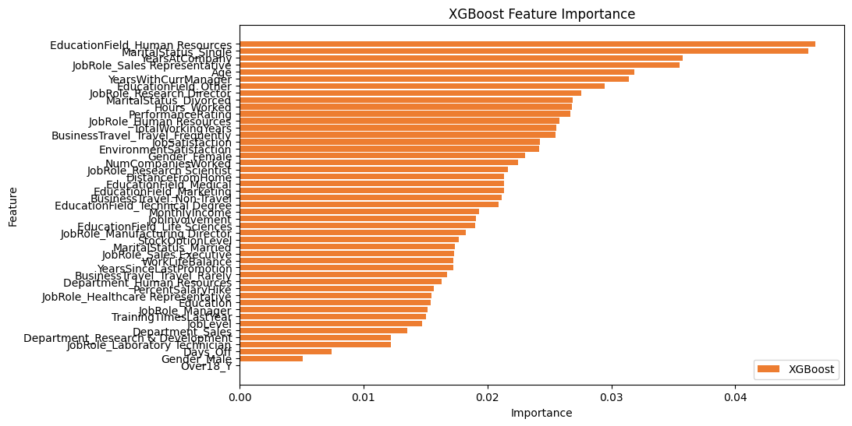

Slide 8
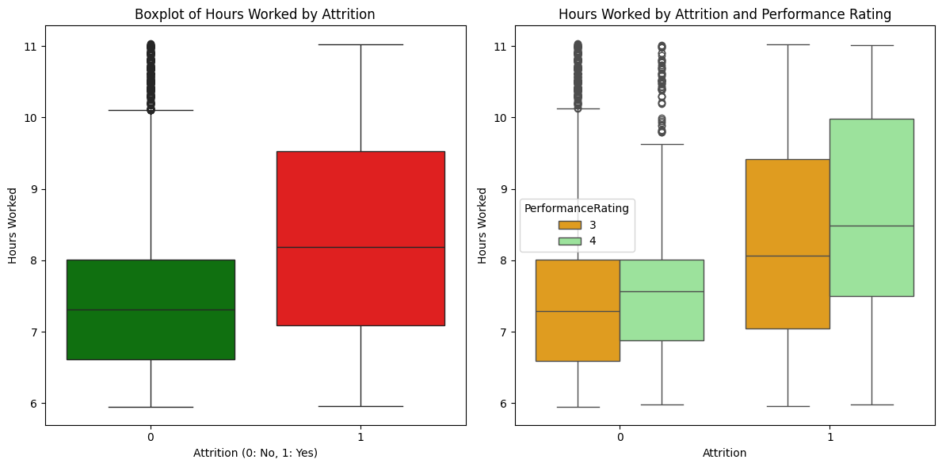
Hours Worked Overall, employees that work longer hours are more likely to leave the company. This may be because of inadequate training or improper skill fit hiring, or unequal work distribution. This may lead to employee having to work longer hours to complete their work. Moreover, employees may be encouraged to work longer to get higher performance rating. This may lead to overwork and burnout.
Set policies to address overwork amongst employees and encourage employees to finish work within working hours (below 8). In the case that the workload exceeds working hours, managers must identify areas of work that can be further automated or hire additional staff.
Employees that work more hours generally have a higher performance rating, managers must examine their approach to workplace evaluation and address overwork as well as reduce workplace competition.

Slide 9
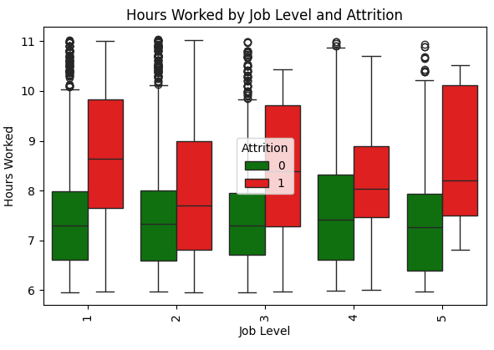
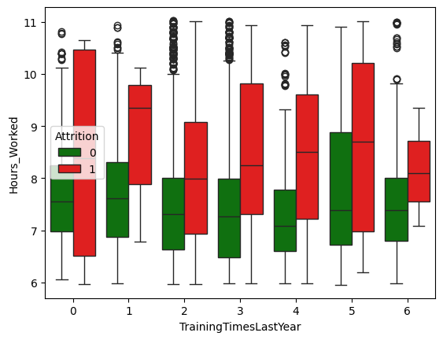
Moreover, managers should also ensure equal work distribution and proper remuneration for the extended hours (see MonthlyIncome)
Training plans need to be examined by the company in teaching employees the proper skills to efficiently finish their work. Training does not seem to significantly reduce the number of hours worked, suggesting either 1) the training is not adequate in addressing employee workload, or 2) the number of hours worked is not related to training and may be related to unequal workload.

Slide 10
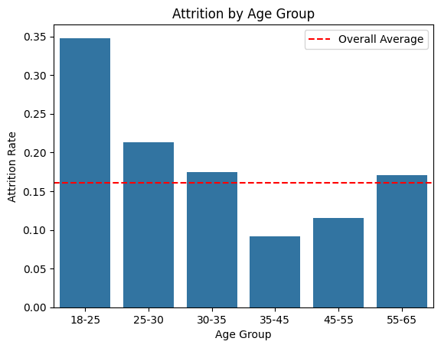
Age Younger age groups are more likely to leave the company, especially the youngest age groups such as 18-25 have an attrition rate of around 34%, whilst 25-35 have an above average attrition rate of 19%. This is possibly due to a lack of career growth opportunities or skill development opportunities.
Conduct a more comprehensive identification of career goals of younger individuals who join the company, orgnaize one on ones with younger employees to further understand what specific programs to develop to meet their goals.
This is usually related to training and development opportunities to gain experience or career progression, thus the telecommunication company may consider implementing a more robust learning and development program as well as career rotations and a career path to ensure younger employees are more inclined to stay.

Slide 11
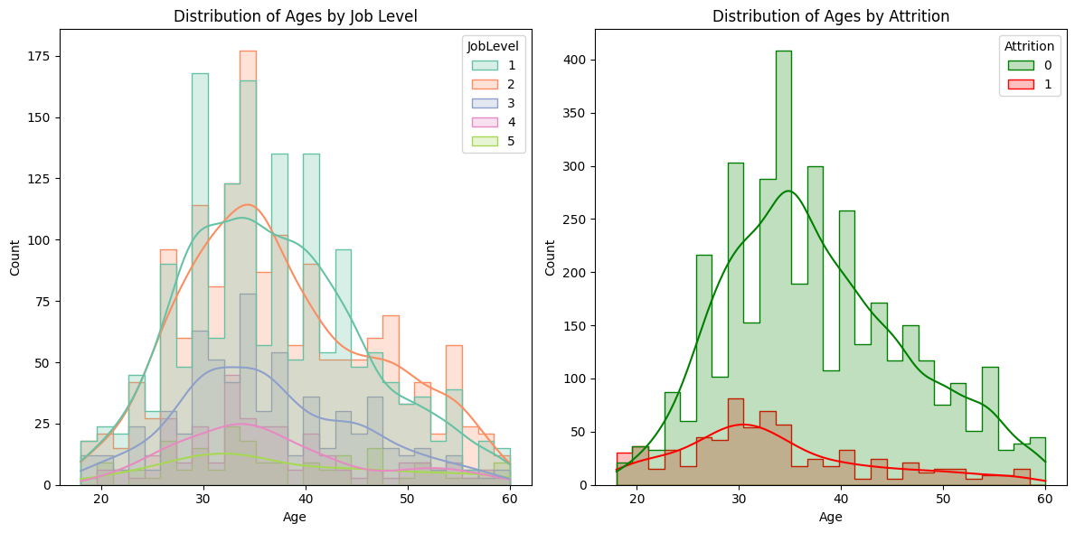

Slide 12
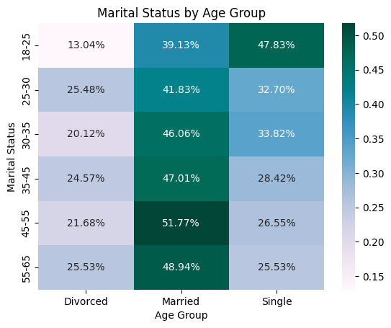
Marital Status Employees that are single are more likely to leave the company (25%), compared to those that are married or divorced (15%). This is directly linked to their age, where younger people tend to be single and have less responsibilities or obligation to the others.
Single employees are likely to have a different set of priorities than those that are married or divorced, this includes expanding their network or connections. The company may conduct further investigation into their objectives, as well as organize events that meet their needs (travel, experiences?)

Slide 13
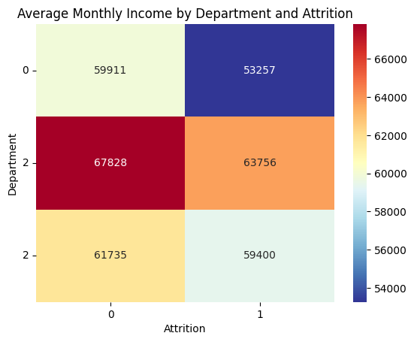
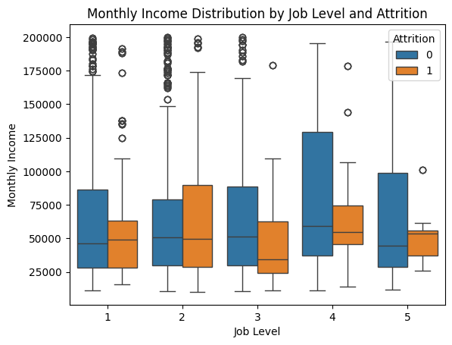
Monthly Income Despite workers working more hours, the compensation of the employees that leave the company are on average less than those who stay. This can be related back to the different departments, where employees that left received on average 5000 less than those who stayed in the company. Considering they are overworked, a proper compensation plan must be awarded for those who work longer hours.
Develop a compensation plan for employees that choose to work longer hours, as the employees that leave the company on average work longer but earn a lower monthly income.
Identify the industry standard level of compensation for departments, especially HR (where the mean monthly income of employee attrition is 5000, which may be lower than industry standard and encourage them to leave the company.

Slide 14
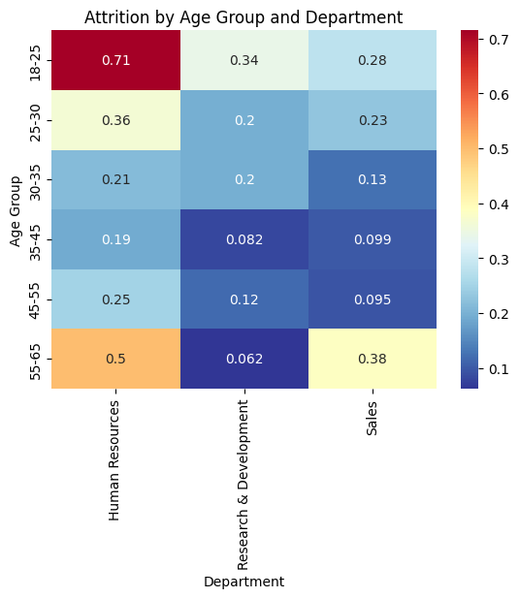
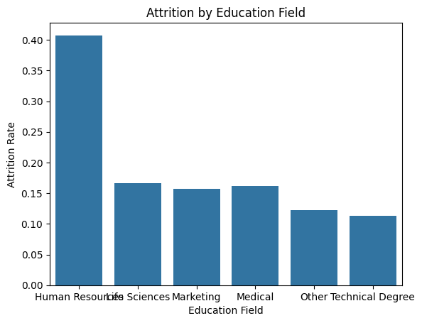
Human Resources Department There is a high amount of turnover in the HR department (30%), compared to the other departments (~15%). This is not related to the number of hours worked and employees and managers have similar sentiment compared to other departments. More has to be done to ensure HR employees stay.
To address high HR department turnover, the company must launch an investigation into the key factors contributing to high turnover within the department. This seems to be related to the fact that there is high turnover for younger employees (71%) and all age levels. For younger employees, perhaps more training and development opportunities or career progression is needed.
This may be related to the lower monthly income that HR department receives and more must be done to investigate industry standard pay (see point 5).

Slide 15
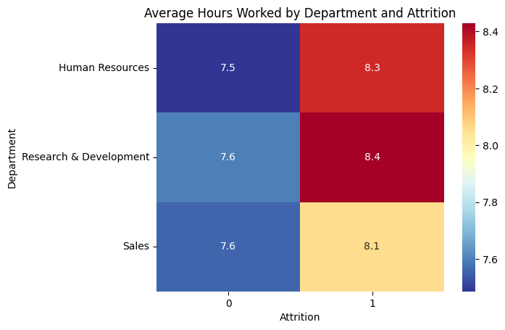

Slide 16
Recommendations
Data Collection
Automatically join files based on the employeeid column in one large file to increase efficiency of data collection/analysis.
Set automatic reminders for employees to fill in any missing values in their surveys or other missing data points. This can improve accuracy of the model to not base off mean values.
Include industry standard average attrition rates for similar companies and departments to allow good comparison (pay, hours)
Data Analysis
Consolidate the variables as there are too many variables that may affect the accuracy or validity of the predictive models and lead to overfitting due to the model being too complex. This may be why the XGBoost model has a 97-98% performance in the macro scores of f-1, precision and recall.
Automatically calculate variables such as hours worked, days off and other predictive variables that are included in the model.
Create a dashboard visualization that tracks key variables to assist analysis over time, assuming this is not a one off project but to track changes after implementing recommendations, a dashboard visualization can assist the company in quickly understanding areas of improvement.

